Slide 1


Slide 2

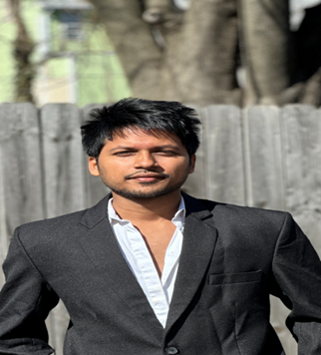
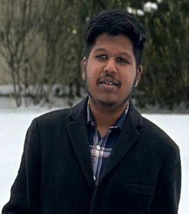

CHRONIC CARE RAG: DIABETES & HYPERTENSION
Our Team
Lakshman Rajith Rongala
Vittu Ramadasu Darshan
Yogananda Manjunath

Slide 3
PROBLEM STATEMENT
Diabetes + Hypertension are among the most common chronic conditions worldwide.
Patients often struggle to find accurate, reliable, evidence-based answers to their questions.
01
02
Existing chatbots give generic answers without verified sources
Build a Retrieval-Augmented Generation (RAG) system to answer questions using trusted medical sources.
03
04

Slide 4

OBJECTIVE
Build a RAG system for diabetes & hypertension guideline
Use open-source LLMs(DistilGPT2, GPT2-Medium, GPT2-Large)
Compare:
  Baseline (no RAG)
  RAG answers (with retrieved context)
Evaluate groundedness, correctness, and hallucinations
Analyze performance across 3 model sizes

Slide 5
DATASET/CORPUS
Source Used | Preprocessing
Peer-reviewed articles (PubMed, PMC) Diabetes–Hypertension comorbidity papers Clinical guidelines text files Manually created CSV with title, source and category | Converted PDF → text Cleaned special characters Built chunked corpus (150–250 tokens per chunk)

Slide 6
ARCHITECTURE
User Query
Top-k Relevant Chunks
LLM
Retriever (Embeddings)
Prompt Builder
Final response

Slide 7
MODEL 1 – DistilGPT2
Question | Baseline | RAG | Notes
Q1: Health risks (diabetes + hypertension) | Incorrect / Hallucinated | Partially correct | Baseline loops and gives nonsense; RAG uses medical info but doesn’t clearly list risks.
Q2: Effect of high BP on kidneys in diabetes | Incorrect / Off-topic | Partially correct | Baseline rambles; RAG pulls from correct article but answer incomplete.
Q3: Why regular monitoring is important | Incorrect / Hallucinated | Mostly correct | Baseline talks about 'systematic review'; RAG explains organ damage and importance of monitoring.

Slide 8
MODEL 2 – GPT-2 Medium
Question | Baseline (No RAG) | RAG (With Context) | Notes
Q1: Health risks when diabetes & hypertension occur together | Partially correct | Partially correct | Both mention real risks but are noisy and unclear.
Q2: Effect of high blood pressure on kidneys in diabetes | Partially correct / off-target | Partially correct / off-target | Talks about diabetes/BP but doesn’t explain kidney damage.
Q3: Why regular monitoring is important | Mostly correct | Incorrect / Confusing | Baseline explains monitoring well; RAG output becomes repetitive and unclear.

Slide 9
MODEL 3 – GPT-2 Large
Question | Baseline (No RAG) | RAG (With Context) | Notes
Q1: Health risks when diabetes & hypertension occur together | Partially correct | Partially correct | Both mention general T2D risks but still fail to clearly list combined complications.
Q2: Effect of high blood pressure on kidneys in diabetes | Mostly correct | Partially correct / Off-target | Baseline explains kidney damage; RAG talks more about insulin resistance than kidneys.
Q3: Why regular monitoring is important | Partially–Mostly correct | Mostly correct | Both link monitoring to risk detection; RAG gives clearer explanation for treatment and complications.

Slide 10
COMPARATIVE STUDY
Model | Baseline | RAG | Overall
Model 1 – DistilGPT-2 | Hallucinated / Off-topic | Partially correct | Weak
Model 2 – GPT-2 Medium | Partially correct | Inconsistent | Moderate
Model 3 – GPT-2 Large | Mostly correct | Mostly correct | Best
As model size increased, both baseline and RAG answers improved, but none reached medically reliable accuracy

Slide 11

KEY CHALLENGES
Limited Medical Understanding
Hallucinations in baseline models
Context mismatch during retrieval
Insufficient depth in answers
Computation and memory limits on Colab

Slide 12
IMPROVEMENTS
Use medically trained models like BioGPT, Meditron, or ClinicalBERT for more accurate clinical reasoning.
Expand the evaluation dataset beyond 3 questions to include broader medical scenarios.
01
02
Improve chunking and retrieval using better segmentation, embeddings, or domain-specific vector indexes.
Add automatic evaluation metrics such as BLEU, ROUGE, or medical accuracy scoring.
03
04

Slide 13
CONCLUSION
The project demonstrates how Retrieval-Augmented Generation can improve answer quality compared to baseline LLM outputs.
RAG reduced hallucinations but performance still depended heavily on model size and training data.
01
02
Model 3 (GPT-2 Large) gave the most fluent and coherent answers but remained limited in medical depth.
Overall, RAG is valuable, but reliable medical QA needs domain-specific models and stronger retrieval.
03
04

Slide 14
THANK YOU

